Slide 1

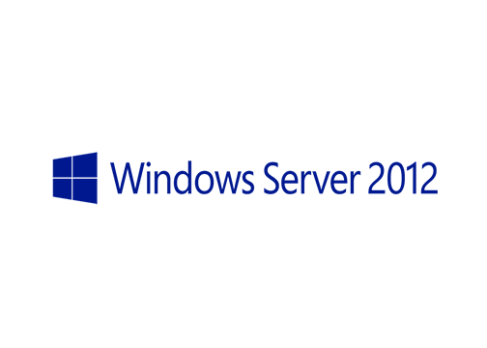
MegaSeries
Configure Constrained Delegation for Hyper-V Migration with Powershell

Slide 2
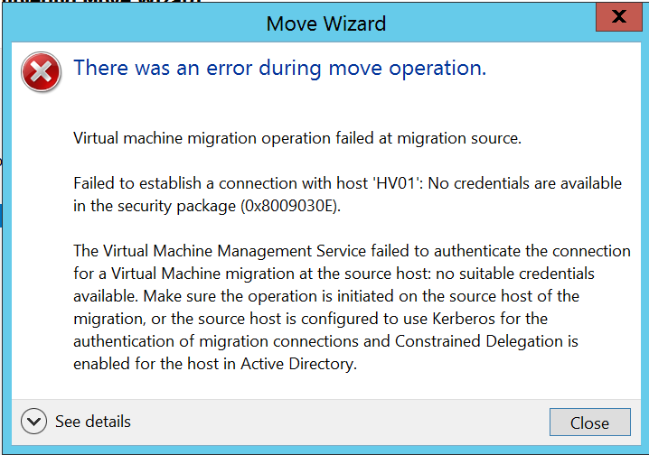
Info
If you want do to a live migration and you are not directly on the source Hyper-V server then you will get an error similar to:

Slide 3
Explanation
This happens because when you live migrate a machine you will start the task on the source server and also contact the destination server
Since you authenticated to the source server from a remote computer, it cannot pass your credentials over to another server because Active Directory does not permit a second hop for credentials
This scenario is also true if you log on the destination server, remote into the source and try a live migration

Slide 4
The solution (the secure solution)
To solve the problem you need to set up Active Directory Constrained Delegation
Each Hyper-V host should trust the other one for credential delegation to live migrate machines between them
This can be done with ADUC and Powershell
The 2 services to trust are:
CIFS
Microsoft Virtual System Migration Service

Slide 5
https://www.youtube.com/channel/UCcZ-jLbPwNr8E_v9-65n8Iw https://github.com/itknowledge4

